Slide 1



CONSUMER GOODS
AD-HOC INSIGHTS

Slide 2
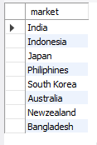
Market Presence of "Atliq Exclusive" in APAC Region
QUESTION:
1. Provide the list of markets in which customer "Atliq Exclusive" operates its business in the APAC region.
OUTPUT:

Slide 3

Percentage Increase in Unique Products from 2020 to 2021
QUESTION:
2. What is the percentage of unique product increase in 2021 vs. 2020? The final output contains these fields, unique_products_2020, unique_products_2021, percentage_change
OUTPUT:

Slide 4
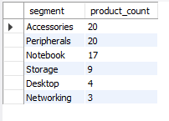
Unique Product Counts by Segment
QUESTION:
3. Provide a report with all the unique product counts for each segment and sort them in descending order of product counts. The final output contains 2 fields, segment, product_count
OUTPUT:

Slide 5
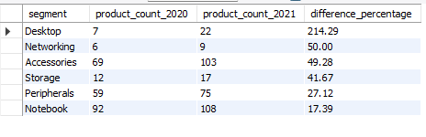
Segment with Highest Increase in Unique Products (2021 vs 2020)
QUESTION:
4. Follow-up: Which segment had the most increase in unique products in 2021 vs 2020? The final output contains these fields, segment, product_count_2020, product_count_2021, difference
OUTPUT:

Slide 6

Products with Highest and Lowest Manufacturing Costs
QUESTION:
5. Get the products that have the highest and lowest manufacturing costs. The final output should contain these fields, product_code, product, manufacturing_cost
OUTPUT:

Slide 7
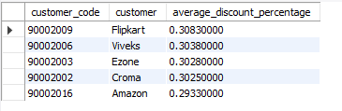
Top 5 Customers with High Average Pre-Invoice Discounts in Fiscal Year 2021 (India)
QUESTION:
6. Generate a report which contains the top 5 customers who received an average high pre_invoice_discount_pct for the fiscal year 2021 and in the Indian market. The final output contains these fields, customer_code, customer, average_discount_percentage
OUTPUT:

Slide 8
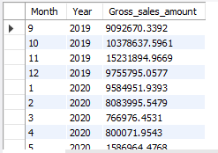
Monthly Gross Sales Analysis for Customer "Atliq Exclusive"
QUESTION:
7. Get the complete report of the Gross sales amount for the customer “Atliq Exclusive” for each month . This analysis helps to get an idea of low and high-performing months and take strategic decisions. The final report contains these columns: Month, Year, Gross sales Amount
OUTPUT:

Slide 9
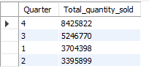
Quarter with Maximum Total Sold Quantity in FY 2020
QUESTION:
8. In which quarter of 2020, got the maximum total_sold_quantity? The final output contains these fields sorted by the total_sold_quantity, Quarter, total_sold_quantity
OUTPUT:

Slide 10

Channel Contribution to Gross Sales in Fiscal Year 2021
QUESTION:
9. Which channel helped to bring more gross sales in the fiscal year 2021 and the percentage of contribution? The final output contains these fields, channel, gross_sales_mln, percentage
OUTPUT:

Slide 11
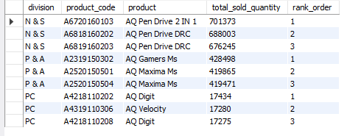
Top Products by Total Sold Quantity in Each Division (Fiscal Year 2021)
QUESTION:
10. Get the Top 3 products in each division that have a high total_sold_quantity in the fiscal_year 2021? The final output contains these fields, division, product_code
OUTPUT:

Slide 12
Thank you for reading

